Slide 1
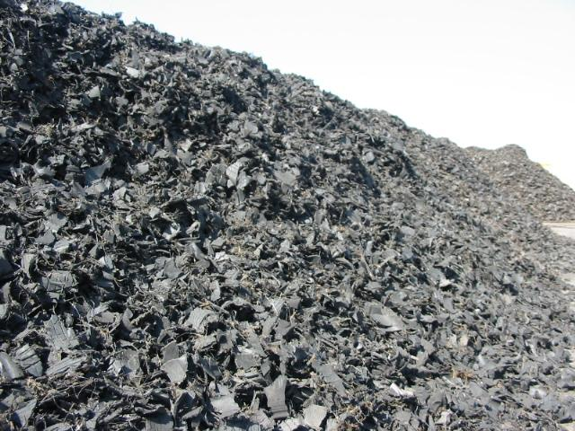
Rubber and Tires
CHEM3010
Presented by: Lauren, Cambria, Emma

Slide 2

Rubber and Tires Chemicals…
What are they?
The chemicals used during the manufacturing process of rubbers and tires that aid in strength, stability, and more durability for better performance.
Synthetic Rubbers
Sulfur & Vulcanization Agents
Plasticizers
Antioxidants and Antiozonants
And more!

Slide 3
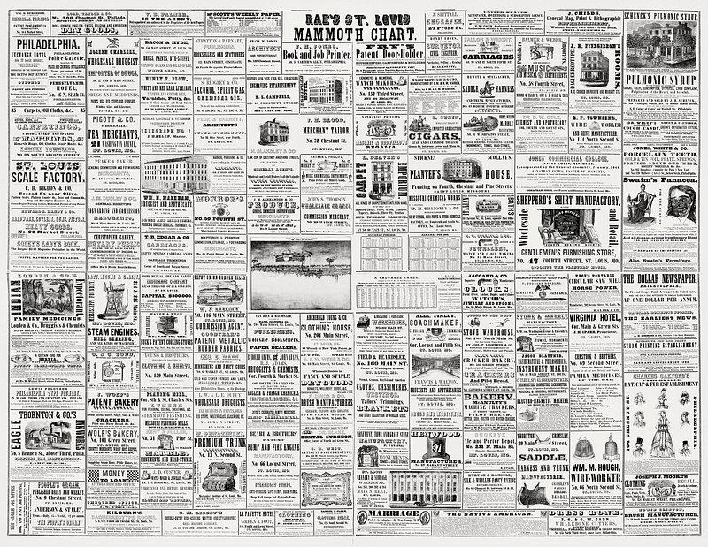
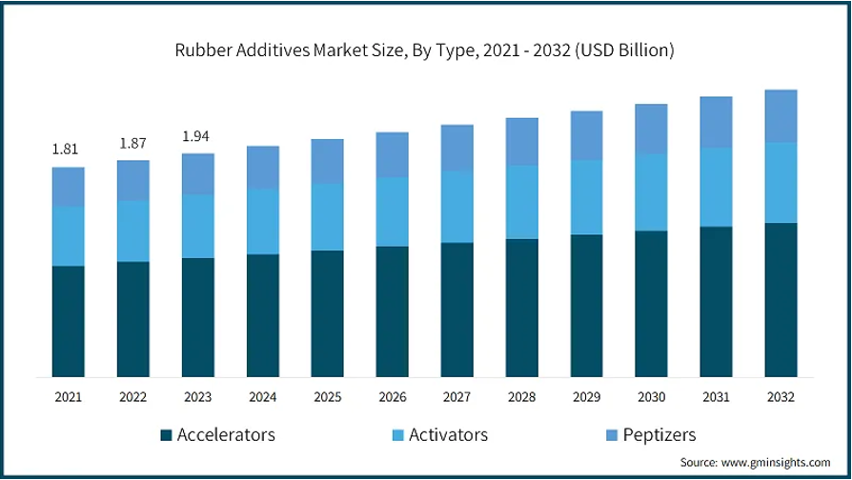
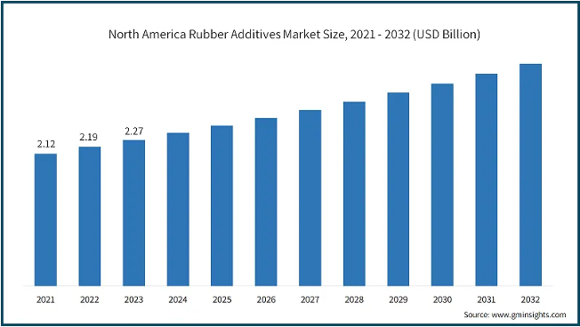
A Growing Demand
Tire manufacturing makes up >60% of the rubber additives sector
$8.3 BILLION → $10.7 BILLION
Growing demand for rubber additives comes from automotive and manufacturing industries as new technology pushes for new, eco-friendly and enhanced quality rubber products.

Slide 4
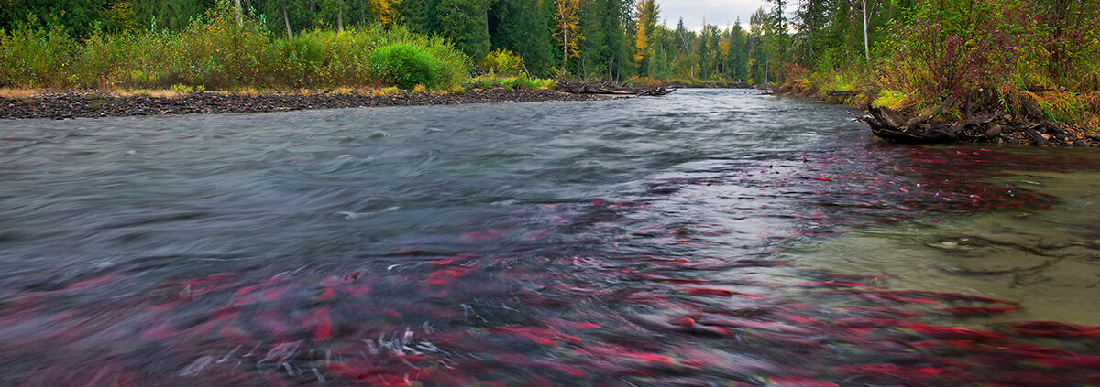
Salmon Mystery Finally Solved
6-PPD found in tires reacts with ozone to form 6-PPD quinone (100x more toxic)
6-PPD from tires leaching into storm drains and into lakes
Turf field runoff (Europe)
Affects coho salmon (West coast)
Salmon are a threatened/endangered species under Endangered Species Act
Trying to get 6-PPD banned in tire production
alternative chemicals
Launched initiative into investigating other tire chemical effects on animals
Further the study to look at the mechanism of how it affects salmon and if it is able to biomagnified in other species of the food chain

Slide 5
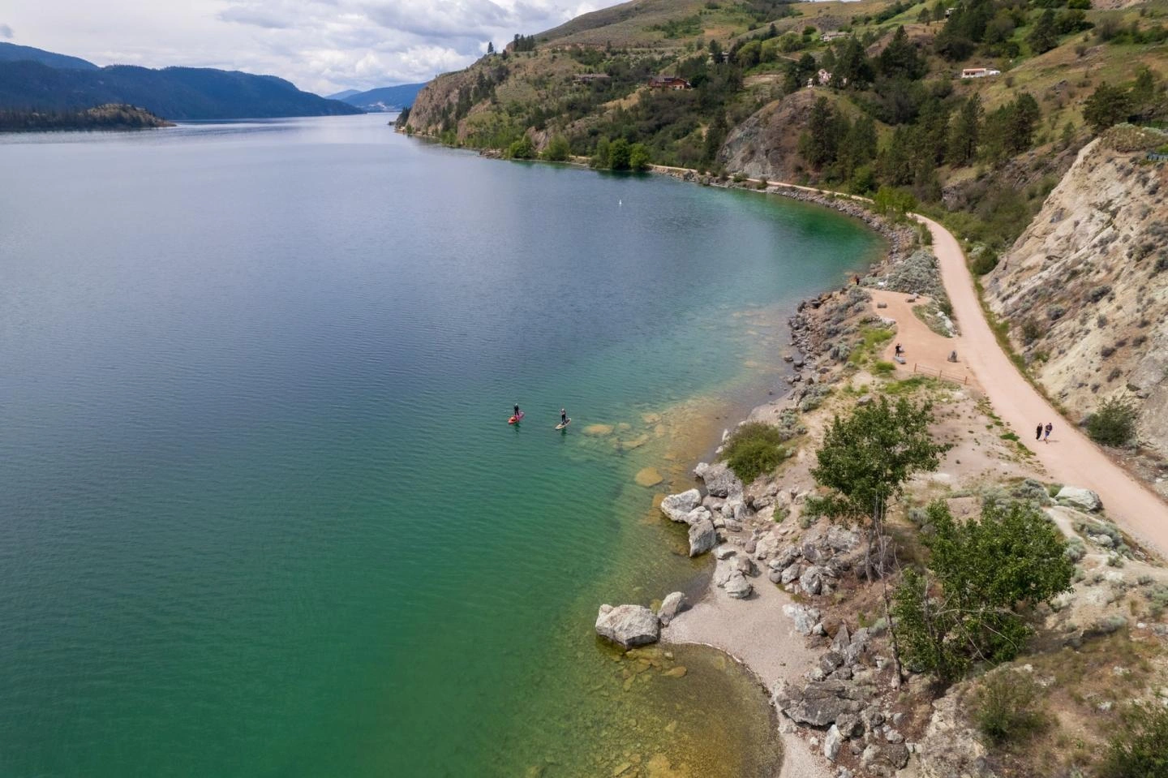

Lake Overview
Located in the Okanagan about 8 km from the city of Vernon.
Popular for swimming and fishing
One of Vernons drinking water sources
Maximum depth: 144m
Surface area: 25.74 sq km
Elevation: 392 m
Volume: 3.70 x10⁹ L of water in Kalamalka Lake

Slide 6
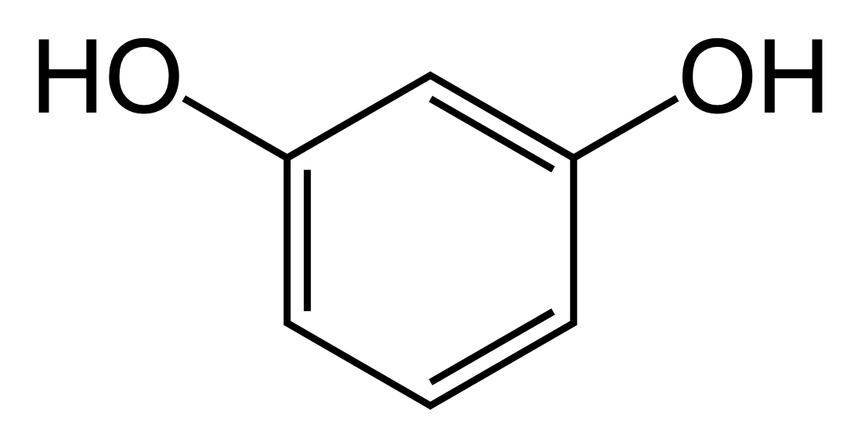
What is Resorcinol?
Health Concern:
Eye/skin irritation
Thyroid issues
Endocrine disruptor
Chlorination:
Forms the THM Chloroform [3]
Headache, dizziness, respiratory failure, liver/kidney damage
Uses:
Manufacturing of hair dyes, pharmaceuticals, flame retardants, fungal cream, wood adhesive
Primary use is in the rubber and tire industry make up to 50% of resorcinol use
Adhesive used to strength the rubber-cord interface to reduce rolling resistance and increase the stability and durability of tires [9]
Tires are used in cars, trucks, and conveyor belts [2].

Slide 7
Environmental Concentration Estimates (Resorcinol)
•Low Kaw, little will partition into air
•Low Kow, prefers water over lipids, OM
•Low Kd, will stay more in water column over soil
•Low BCF, will not bioaccumulate/magnify
Molar Mass | M | 110.11 mol/L
Solubility | S | 7.17x10⁵mg/L
Air-Water Partition Coefficient | Kaw | 2.0x10⁻⁹
Octanol-Water Partition Coefficient | Kow | 7.1
Soil Sorption Coefficient | Koc | 10.36
Bioaccumulation Factor | BCF | 3.2

Slide 8

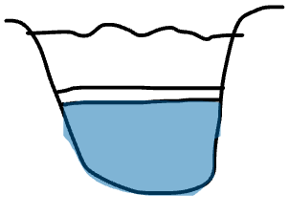

Environmental Concentration Estimates (Resorcinol)
[Trailer]
[Hypolimnion]
Soil Partitioning
S= 7.17x10⁵ mg/L
V= 55000 L
Ci= 6.51 mol/L
70% of the lake
3.36x10⁻⁷mol/L
foc= 0.5%
Cw= 3.20x10⁻⁷mol/L
🎉
[Final]
Air Partitioning
Fall turnover (dilution)
🎉
Cw= 2.23x10⁻⁷mol/L
Ca=4.48x10⁻¹⁶mol/L
Cw= 2.24x10⁻⁷mol/L

Slide 9


Toxicology and Regulations (Resorcinol)
Exposure Pathway | Exposure Limit | Calculated Concentration
Oral (general public) | 0.4 mg/kg dw (DNEL) | Cw= 0.0485 mg/kg
Inhalation (workers) | 0.8 mg/kg bw (DNEL) | Ca= 6.41x10⁻¹⁶ mg/kg
Dermal (general public) | 20 mg/kg dw (DNEL) | Cw=0.0319 mg/kg
Cl
DWTP:
Resorcinol
Chloroform
Exposure Limit | Calculated Concentration
0.100 mg/L | 0.0382 mg/L

Slide 10
Risk Assessment/Recommendations (Resorcinol)
Concentration levels are below all regulations for oral, dermal and inhalation of resorcinol
Chloroform by-product at the DTWP is below regulation levels
No concern for other organisms
Do not need to take any other actions to eliminate resorcinol

Slide 11

2,3-dihydro-1,3-benzothiazole-2-thione AKA 2-Mercaptobenzothiazole AKA ‘MBT’
C₇H₅NS₂
167.24 g/mol
RAPID FIRE FUN FACTS
Not naturally occurring chemical in nature.
Non-polar molecule containing a benzene ring.
Commonly found in salt forms: zinc MBT and sodium MBT.
Can be found in common rubber products such as latex gloves.
A solid, yellow, needle-like crystalline compound.

Slide 12
What is 2-Mercaptobenzothiazole (MBT) Used For ?
Vulcanization Accelerator
AKA speeds up the reaction process between rubber and sulfur molecules to make raw rubber more durable and elastic.
Corrosion Inhibitor for automobile and metalworking fluids
Flotation Reagent in mining industry
AKA aids in separating minerals from water during ore extraction.
AKA forms a protective layer on metal surfaces to prevent corrosion.

Slide 13
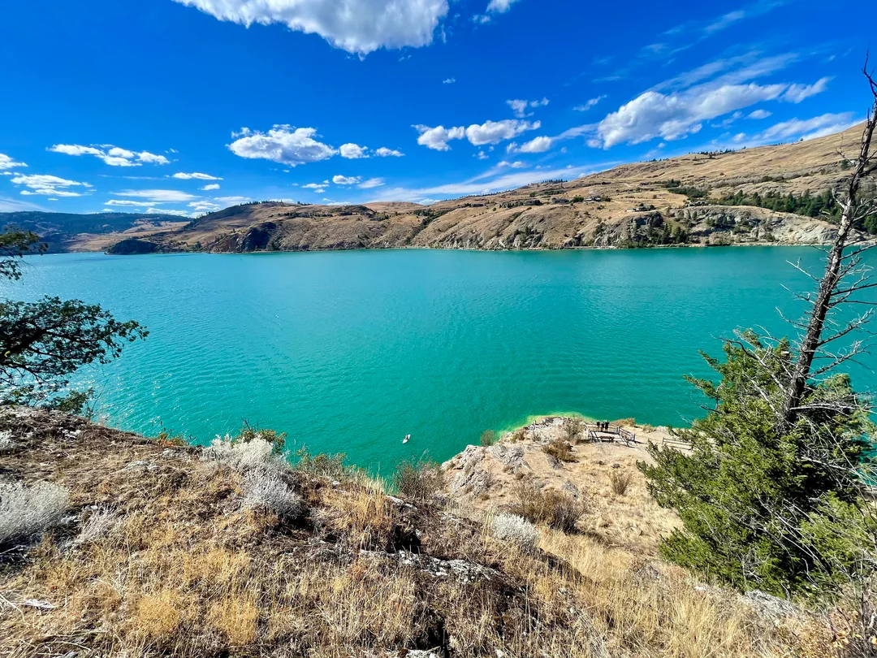
Always check your tires…
What Happened?
Truck carrying 1000 kg solid 2-mercaptobenzothiazole lost two of its tires and fell into the middle of Kalamalka Lake.
The truck sunk to the bottom and was punctured, allowing for all MBT to escape into the lake.
Concentration at Max Solubility: 0.118g/L
Figure 1. Kalamalka Lake

Slide 14
Concentration of 2-Mercaptobenzothiazole in the lake?
1,000 kg
1000 g
1 kg
1 cm³
1.42 g
1 L
1000 cm³
V1
C1
Concentration at Max Solubility: 0.118g/L
704.225 L
V2
Now put it all together!
1.52x10¹² L
(0.118g/L)(704.225 L)
C1V1 = C2V2
5.46x10⁻⁸ mg/L
(1.52x10¹² L)
Convert from grams to milligrams !

Slide 15
Table 2. Partition Coefficients
How much MBT is actually in the lake water?
Octanol-Water partition coefficient (logKow) | 2.41
Air-Water partition coefficient (Kaw) | 1.448x10^-7
Soil Adsorption Coefficient (Koc) | 326-3560 mL/g
Bioconcentration Factor (BCF) | <0.842 (6 weeks - Carp)
Bioaccumulation Factor (BAF) | 0.1 (42 days - Carp) mL/g at 25C
Low bioconcentration and cannot biomagnify
Negligible Partition to Atmosphere
Preference is to Remain in Water
5.41x10⁻⁸ mg/L 2-mercaptobenzothiazole in the lake
Moderate Partition to Soil/Sediment
Assuming 20% foc based on TOC (~4.40 mg/L) in Kalamalka Lake
Kd = 388.6 L/mg
Koc = 1943 mL/g (average value)
Notes:
Does not readily biodegrade

Slide 16
Table 3. Toxicity of 2-Mercaptobenzothiazole
Limited evidence indicates a positive association between MBT and bladder cancer in humans.
Sufficient evidence in carcinogenicity in animal experiments.
 | Dose | LOAEL | NOAEL [NOEC in mg/L per day]
Mice LD50 (oral) mg/kg bw | 1850-2000 | Subchronic Oral: 134 mg/kg-day | —
Rat LD50 (oral) mg/kg bw [LC50] | 1680-3800 [oral: >1270 4h] [inhale: >0.7 7h] | 300 mg/kg-day (developmental) 172.1 mg/kg-day (reproductive) | 1200 mg/kg-day (developmental)
Rabbit LD50 mg/kg bw | Oral: 7500-8750 Dermal: >7940 | — | 300 mg/kg-day (developmental)
Rainbow Trout LC50 𝝻g/L | 1000 24h 460 48h 420 96h | — | [0.041 89 days]
Bluegill Fish LC50 𝝻g/L per time | 2300 24h 2000 48h 1900 96h | — | —
Water Flea LC50 𝝻g/L per time [EC50 mg/L per time] | 4190 48h 1250 7 days | — | [[0.08 mg/L 21 days]]
“Very toxic to aquatic life with long-lasting effects”
- IARC
Increased incidence of hepatocellular adenomas or carcinomas (combined) & relative liver weight in mice
Group 2A - Probably Carcinogenic to humans

Slide 17
Regulations Reported on SDS
No current threshold limits for MBT in Canada.
Occupational Exposure Limits:
Inhalable Particulates - 10 mg/m³
Respirable Particulates - 3 mg/m³
Workplace Environmental Exposure Limit:
Dermal: 5 mg/m³ for 8 hours
USA regulations focus on chemical manufacturing and handling being reported by production facilities.
MBT precursor regulations focus on release notification and regulation.
Group 2A - Probably Carcinogenic to humans
IARC Classifications of MBT
Skin Sensitizer to humans and animals
Notes:
Most people come into contact with MBT via things like rubber gloves, and tests show 27% of allergic reactions are to MBT.

Slide 18

YES
YES
Remaining Concern:
Is it safe for the aquatic life at its concentration?
Is it Safe for humans?
Doesn’t approach current occupational or environmental exposure limits
Insignificant concentration of 5.41x10⁻⁸ mg/L in the lake
YES
YES
Concentration is not significant enough to cause adverse effects to aquatic environment
Recommendations:
Notes:
The skin sensitizing dose limits or concentrations are unknown but expected to be at very low concentrations therefore care should be taken for sensitive individuals.

Slide 19
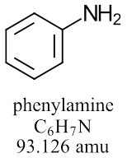
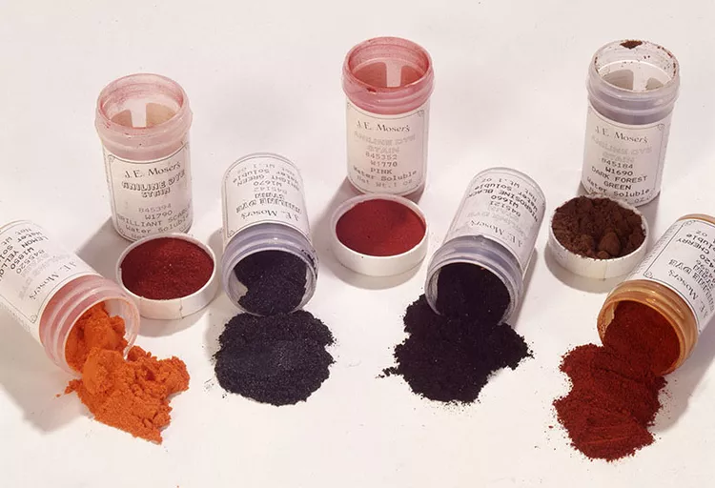
What is aniline used for?
What is aniline?
Aniline in the common name for phenylamine.
Liquid with a light yellow colour
93% of the aniline imported into Canada is used for the synthesis of rubber and polymers
Dyes
Sweeteners
Sulfa Drugs(Antibiotics and burn cream)
Chemicals for photography and agricultural purposes
Figure 1: Aniline IUPAC
Figure 2: Aniline Dyes

Slide 20
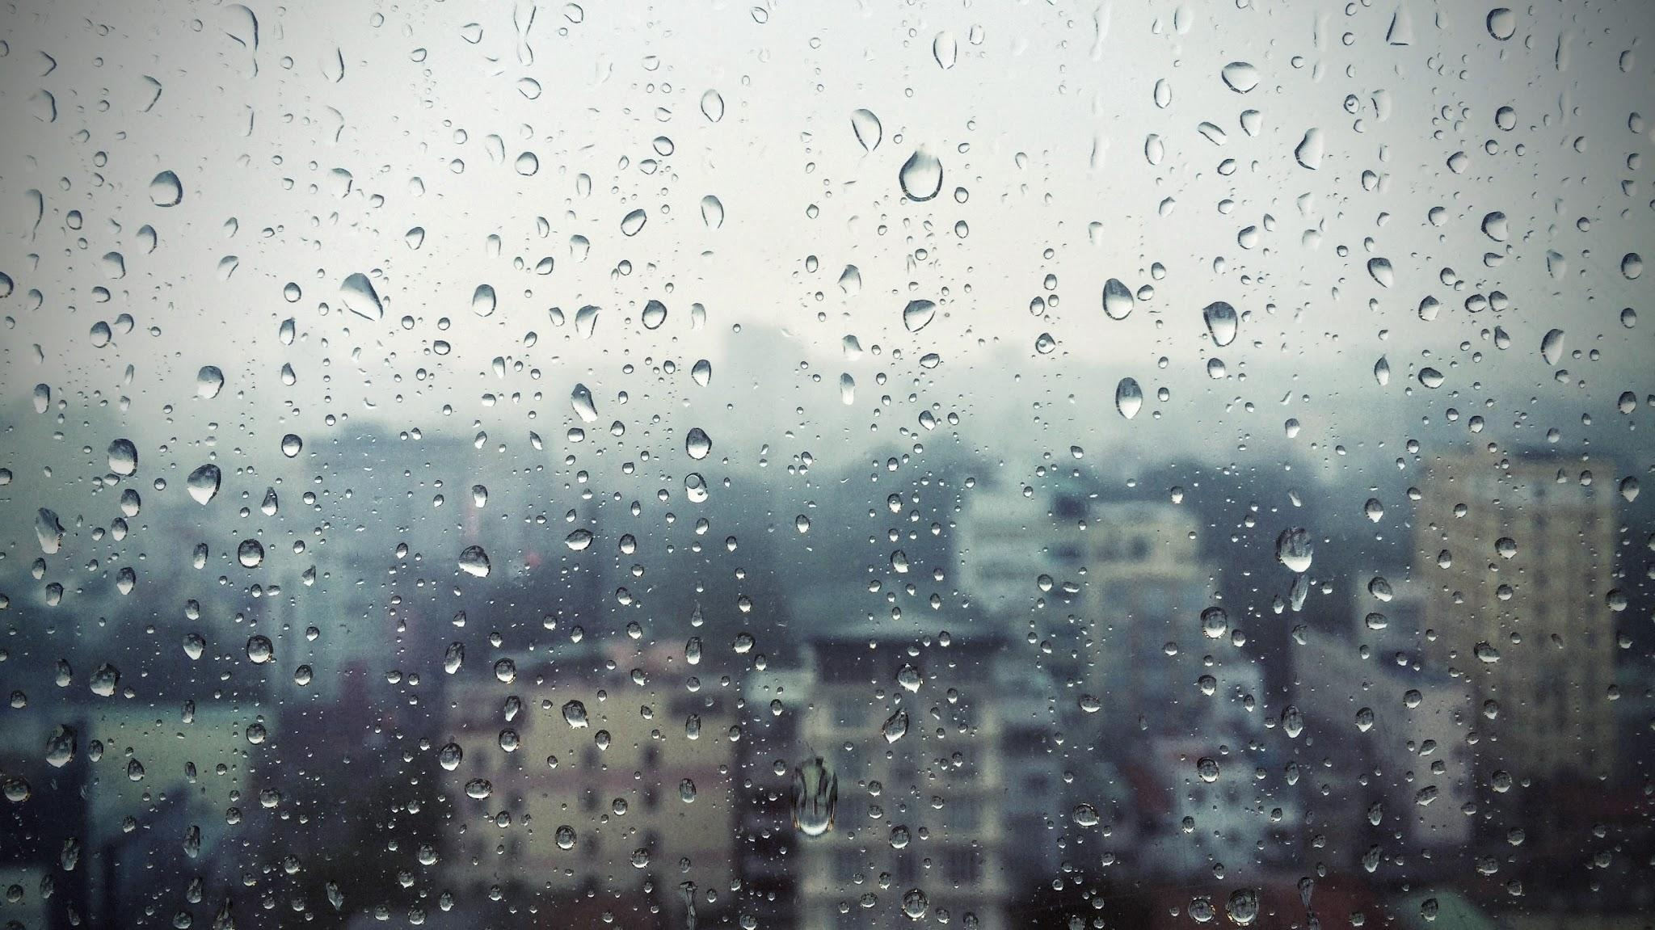
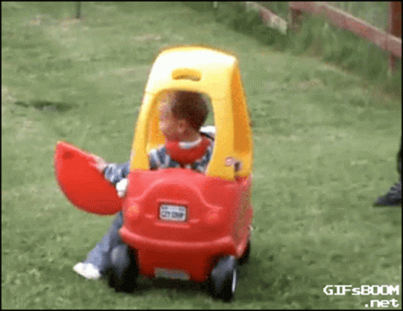
What happened?
On a rainy August night a collision occurred between a Volkswagen Tiguan and a dual trailer carrying 50,000 L of aniline resulting in the dual trailer to swerve into Kalamalka Lake spilling the entirety of its contents.

Slide 21

Environmental Concentration
Volume Calculation:
Depth= 144m
Surface area= 25.74 sq km x 1000 m/km =25740 m
144m x 25740 sq m = 3,700,000
= 3,700,000 m³ water
1m³ =1000L
Volume water = 3.70 x10⁹ L in Kalamalka Lake
Grams= Solubility x L of aniline
3.5 g/L x 50,000 = 1750 g
1750 kg/ 3.70 x 10⁹ L =4.72 x 10 ⁻⁷ kg/L = 472 μg/L

Slide 22
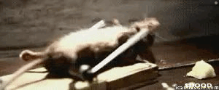
Toxicity and Regulations
Table 1: Toxicological Information
LD50 Oral (Rat) | 250 mg/kg
LD50 Dermal (Rabbits) | 820 mg/kg
LC50 Inhalation (Mouse) | 4h – 248 ppm
Lowest Observed Allowable Effect Level (LOAEL) | 7.2 mg/kg-bw per day
Tolerable Daily Intake (TDI) | 1.4 µg/kg-bw
The Government of Canada says the TDI was derived from the LOAEL due to lack of valid research.

Slide 23
Risk Assessment
Table 2: Partition Coefficients
Aniline does not bioaccumulate and prefers to stay in water over partitioning into octanol and air.The little amount that could partition into the air would degrade quickly. No literature data on partitioning into soil. Since the concentration is so low (472 μg/L) it would not affect the soil.
Partition Coefficient | Value
Kow (Octanol-Water) | 0.9
Log Koa (Octanol-Air) | 4.04
Kaw (Air-Water) | 8.15 x 10⁻¹⁰

Slide 24
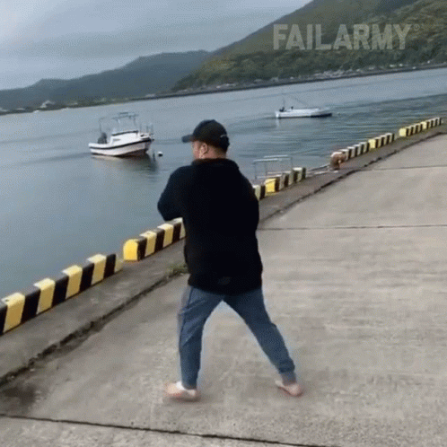

Recommendation
Swimming and fishing in Kalamalka Lake can continue without public concern. Drinking water from the lake can also continue with proper water treatment. Since the concentration is so low (472 μg/L ) the average person (drinks 1.5 L/ day and is 70 kg) would have to drink 1086 L of raw lake water reach the TDI. However, monitoring should continue to ease the concerns of the community

Slide 25
References
Dunagan, C. Discovery of toxic chemical in tires spurs scientific and regulatory interest. 2020. https://www.pugetsoundinstitute.org/discovery-of-toxic-chemical-in-tires-spurs-scientific-and-regulatory-interest/#:~:text=Check%20out%20Water%20Ways%2C%20Nov,chemical%20drives%20mystery%20salmon%20deaths%E2%80%9D. (Assessed November 30, 2025).
Hahn, S., Kielhorn, J., Koppenhöfer, J., Wibbertmann, A., Mangelsdorf, I. Concise International Chemical Assessment Document 71- Resorcinol; WHO, 2006. https://iris.who.int/server/api/core/bitstreams/30ff8258-12a4-4433-bd50-071425bc48ef/content. (Accessed October 3, 2025).
ATSDR. ToxFAQsTM for Chloroform. https://wwwn.cdc.gov/tsp/ToxFAQs/ToxFAQsDetails.aspx?faqid=52&toxid=16. Accessed November 22, 2025).
Government of Canada. Canadian Environmental Protection Act Priority Substances List Assessment Report Aniline; 1995. https://www.canada.ca/content/dam/hc-sc/migration/hc sc/ewh-semt/alt_formats/hecs-sesc/pdf/pubs/contaminants/psl1-lsp1/aniline/aniline-eng.pdf (accessed Nov 6, 2025).
Global Market Insights, Rubber Additives Market Size, Share, & Forecast Report - 2032. Rubber Additives Market Size, Share & Forecast Report - 2032 (Accessed December 1nd)
Dave Heath. Things to Do Beaches and Lakes, Tourism Vernon .https://www.tourismvernon.com/things-to-do/beaches-lakes (accessed Dec 2, 2025).
Wood Magazine Staff. Aniline Dyes. WOOD, 2024. https://www.woodmagazine.com/materials-guide/finishes/aniline-dyes (accessed Dec 2, 2025).
Regional District North Okanogan. Greater Vernon Water; 2025. https://www.rdno.ca/services/greater-vernon-water#:~:text=GVW%20supplies%20all%20potable%20(treated)%20water%20from,each%20with%20an%20intake%20on%20Okanagan%20Lake. (accessed Nov 30, 2025).
Yazıcı, N., et al. The Outstanding Interfacial Adhesion between Acrylo-POSS/Natural Rubber Composites and Polyamide-Based Cords: ‘An environmentally friendly alternative to resorcinol-formaldehyde latex coating’. Science Direct. 2021, 228, 123880. https://www.sciencedirect.com/science/article/pii/S0032386121005036 (Accessed November 9, 2025).

Slide 26
Thank you!

